Slide 1
Exploratory Data Analysis — EDA
Yang Gao
Assistant Professor of Information Systems
Aug 19-20, 2021

Slide 2

Introduction to Data Analysis
Steps in data analysis
Recognize a problem that needs to be solved
Data preparation and exploration
Model building and validation
Model deployment
Track Results and Feedback
It is up to you to ask good questions and then take advantage of the most appropriate tools to answer them.
Find a business problem
Deploy the model
Collect the data
Evaluate the model
Prepare the data
Create a model

Slide 3
Data Exploration
Exploratory data analysis (EDA) is the part of statistical practice concerned with reviewing, communicating, and using data where there is a low level of knowledge about its cause system.
Typically the first step in analyzing data.
Makes heavy use of graphical techniques (e.g., bar charts, pie charts, and histograms).
Also makes use of simple descriptive statistics (e.g., mean and variance).
Purposes of EDA
Uncover the underlying structure.
Extract important variables.
Detect outliers and anomalies.
It is a challenge to summarize data so that the important information stands out clearly.

Slide 4
Populations and Samples
A population includes all of the entities of interest in a study (people, households, machines, etc.)
All potential voters in a presidential election.
All subscribers to cable television.
All invoices submitted for Medicare reimbursement by nursing homes.
A sample is a subset of the population, often randomly chosen and preferably representative of the population as a whole.

Slide 5
Descriptive and Inferential Statistics
Descriptive Statistics
You have the data for the whole population.
Techniques to describe the whole data.
Parameters like mean, standard deviation etc.
Describe and understand the data in powerful ways.
Inferential Statistics
You have a sample and want to generalize to the whole population.
Mean, standard deviation etc. are statistics, not parameters.
Steps: 1) modeling (hypotheses); 2) estimating parameters; 3) estimating errors via testing.

Slide 6



Why Sampling?
The difference between sample results and actual results ranged between 0 - 3%.

Slide 7
Data Sets, Variables, and Observations
A data set is usually a rectangular array of data, with variables in columns and observations in rows.
A variable (or feature or attribute) is a characteristic of members of a population, such as height, gender, or salary.
An observation (or case or record) is a list of all variable values for a single member of a population, a.k.a., feature vector.
Think of the data set as a table.
Columns are variables.
Rows are observations.

Slide 8
Types of Datasets
Cross-sectional data are data at a distinct point in time.
Time series data are data collected over time.
Panel data are cross-sectional time series data.
The type of dataset is a significant factor in analyzing the data and visualizing it.

Slide 9
Understanding Data Types
Numerical data should have mathematical meaning.
Discrete data
Its values are distinct and separate.
It can’t be measured but can be counted.
Continuous data
It represents measurements.
It can be measured but can’t be counted.
Categorical data represents characteristics. It can take numerical value but has no mathematical meaning.
Nominal data
Discrete but unordered units.
Ordinal data
Discrete and ordered units.
Discrete
Numerical
Continuous
Data
Nominal
Categorical
Ordinal

Slide 10
Example of Data Types
Numerical Discrete | Numerical Continuous | Categorical Nominal | Categorical Ordinal
Number of Credit Cards | Income | Product Names | Rankings
Number of Family members | Profit | Sales Zones | Ratings on a scale of 1 to 5
Number of customers |  | Gender
Quantity Sold

Slide 11
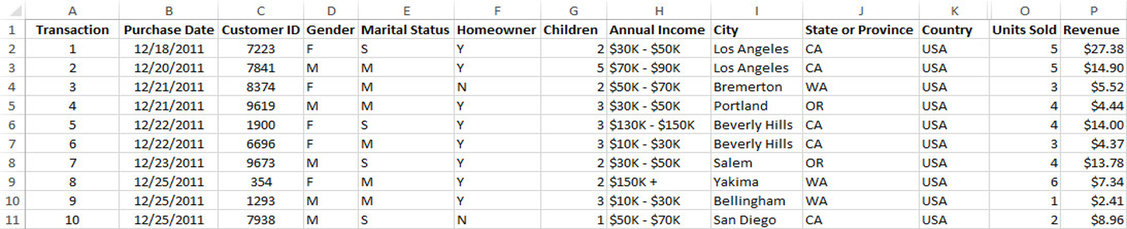
Example — Supermarket Transactions
A data set contains transactions made by supermarket customers over a two-year period.
Transaction and Customer ID are used to identify transactions and customers.
Purchase Date is a date variable.
What variables are numerical? Categorical?

Slide 12
Example — Supermarket Transactions
A data set contains transactions made by supermarket customers over a two-year period.
Transaction and Customer ID are used to identify transactions and customers.
Purchase Date is a date variable.
Numerical variable: Children, Units Sold, and Revenue.
Categorical variables: all the other variables.

Slide 13
Types of Summarizations for Numerical Data
There are many ways to summarize numerical variables, both with numerical summary measures and with charts.
Measures of center: Mean, median, and mode
Measures of spread: Range, variance, standard deviation, and IQR (Interquartile Range)
Measures of distributions: Histogram, boxplot
What is the center?
How are the values spread out?
Are there extreme values?
Is the distribution symmetric?

Slide 14
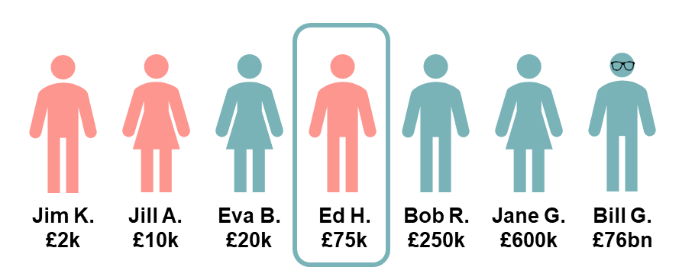
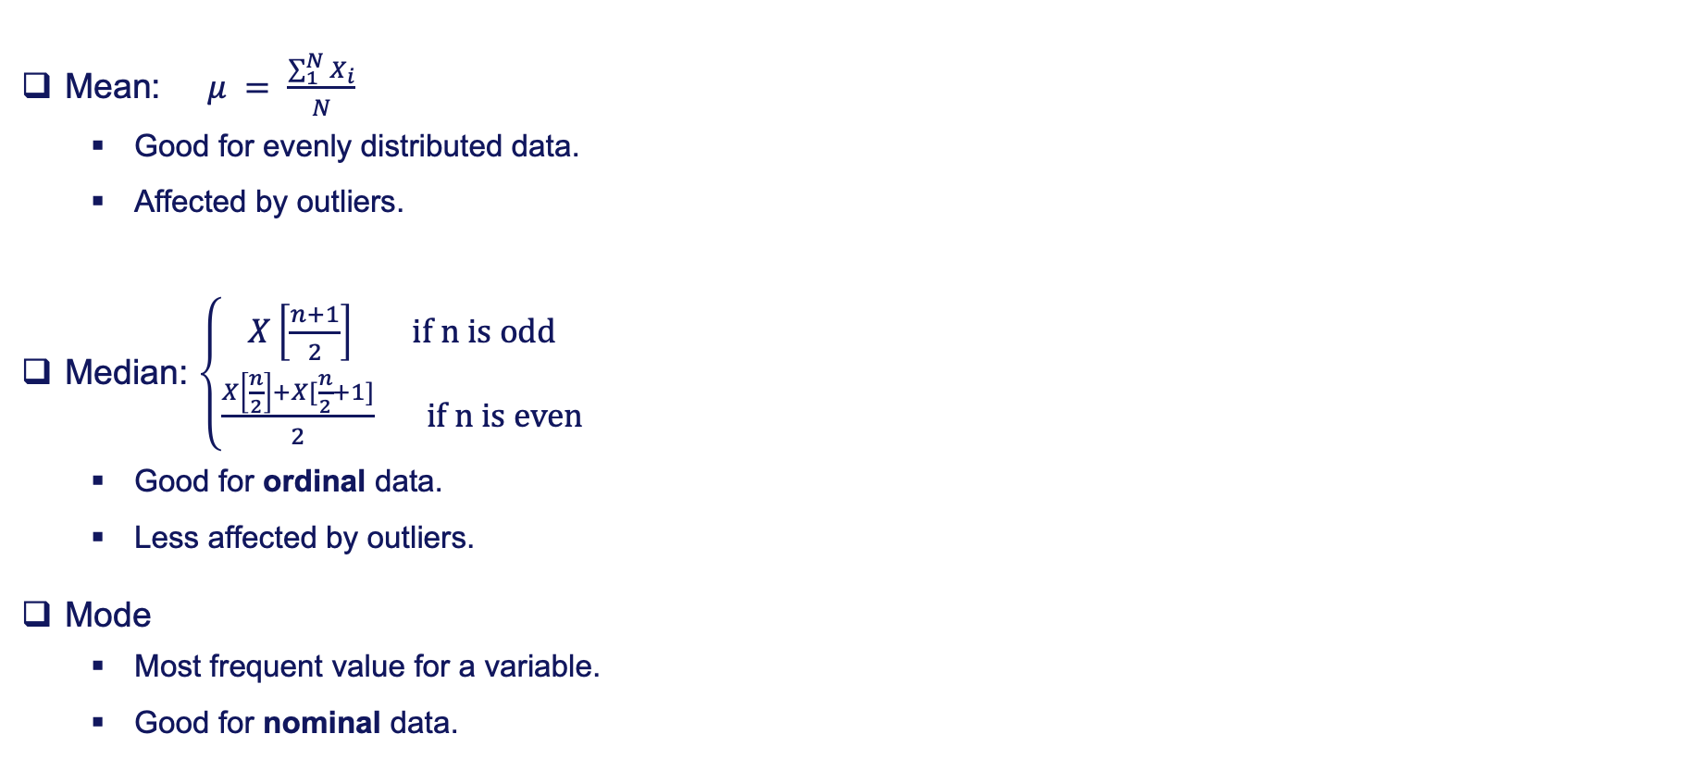
Measuring Center for Numerical Data
Mean:$μ = \frac{\sum_{1}^{N}{X_{i}}}{N}$
Good for evenly distributed data.
Affected by outliers.
Median: $\left\{\begin{aligned}X\left[\frac{n+1}{2}\right] \text{if} \text{n} \text{is} \text{odd} \\ \frac{X\left[\frac{n}{2}\right]+X[\frac{n}{2}+1]}{2} \text{if} \text{n} \text{is} \text{even}\end{aligned}\right.$
Good for ordinal data.
Less affected by outliers.
Mode
Most frequent value for a variable.
Good for nominal data.

Slide 15
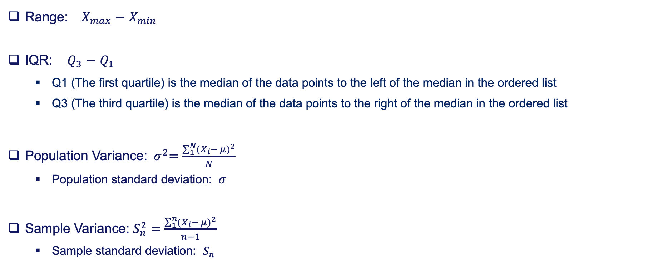
Measuring Spread for Numerical Data
Range: $X_{max}$ $−$ $X_{min}$
IQR: $Q_{3}$ $−$ $Q_{1}$
Q1 (The first quartile) is the median of the data points to the left of the median in the ordered list
Q3 (The third quartile) is the median of the data points to the right of the median in the ordered list
Population Variance: ${ σ}^{2}=\frac{\sum_{1}^{N}{{{(X}_{i}− μ)}^{2}}}{N}$
Population standard deviation: $σ$
Sample Variance: $S_{n}^{2}=\frac{\sum_{1}^{n}{{{(X}_{i}− μ)}^{2}}}{n−1}$
Sample standard deviation: $S_{n}$

Slide 16
Distribution Analysis for Numeric Data — Histograms
A histogram is the most common type of chart for showing the distribution of a numerical variable.
It is based on binning the variable — that is, dividing it up into several categories. Bins are also sometimes called "intervals", "classes", or "buckets”.
It is a column chart of the counts in the various categories. The heights of the bars tell us how many data points are in each bin.
A histogram is great for showing the shape of distribution (symmetric or skewed).

Slide 17
Distribution Analysis for Numeric Data — Histograms
The right plot is a histogram that represents the distribution of cable diameters in a manufacturing process.
The blue curve is the density curve, which is better at displaying the distribution shape.
The distribution looks symmetric around the cable diameter mean (0.546 cm) and appears to fit the Normal Distribution fairly well.

Slide 18
Distribution Analysis for Numeric Data — Boxplots
A box plot (or box-whisker plot) is an alternative type of chart for showing the distribution of a variable.
A box plot displays the five-number summary of a set of data. The five-number summary is the minimum, first quartile, median, third quartile, and maximum.

Slide 19
Distribution Analysis for Numeric Data — Boxplots
The left image is a comparison between a boxplot and the probability density curve.
The distribution is the normal distribution.

Slide 20
Types of Summarizations for Categorical Data
There are only a few possibilities for describing a categorical variable, all based on counting.
Bar graph, pie chart, and two-way frequency tables.
Count the number of categories
Give names to the categories
Count the number of observations in each category
Visualize the frequency distribution

Slide 21
Types of Summarizations for Categorical Data
There are only a few possibilities for describing a categorical variable, all based on counting.
Bar graph, pie chart, and two-way frequency tables.

Slide 22
Outliers
An outlier is a value or an entire observation (row) that lies well outside of the norm.
Some statisticians define an outlier as any value more than three standard deviations from the mean, but this is only a rule of thumb.
When dealing with outliers, it is best to run the analyses in two ways.
With the outliers.
Without the outliers.

Slide 23
Outliers
Methods to detect outliers.
Interquartile range (IQR): an observation is considered as an outlier if it falls out of the interquartile range.
Boxplot
Scatterplot
…

Slide 24
Missing Values
Most real data sets have missing values in the data.
The first issues is how to detect missing values.
The more important issue is what to do about the detected missing values.
First of all, you need to understand why there’re missing values.
Sometime missing values will also provide information, for example, people with high salaries generally do not want to reveal their incomes in surveys.
One option is to simply ignore them. Then you will have to be aware of how the software deals with missing values.
Another option is to fill in missing values with special values.
A third option is to fill in missing values with the average of non-missing values, but this isn’t usually a very good option.
You can also examine the non-missing values in the row of a missing value; these values might provide clues on what the missing value should be.

Slide 25
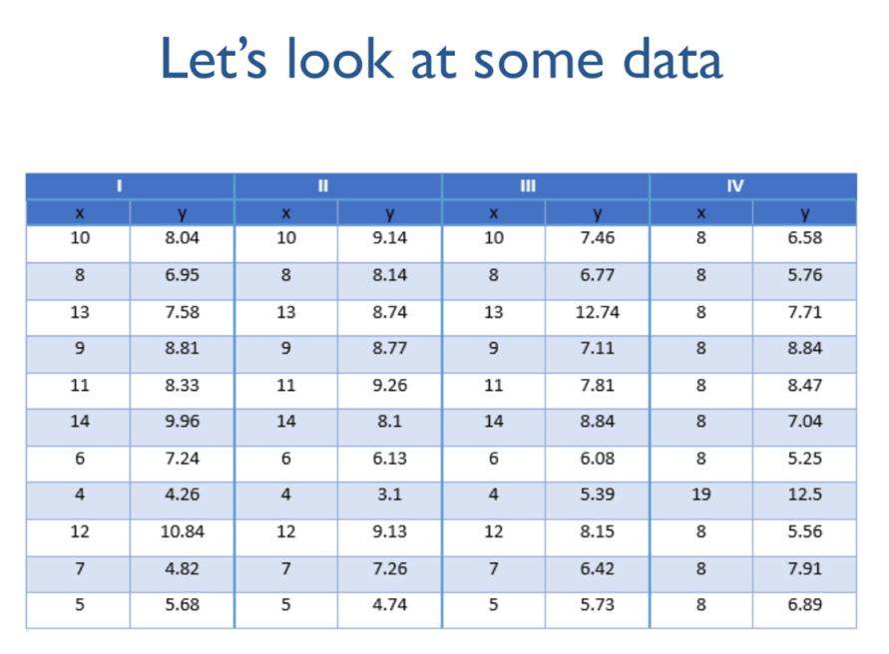
Need for Data Visualization

Slide 26
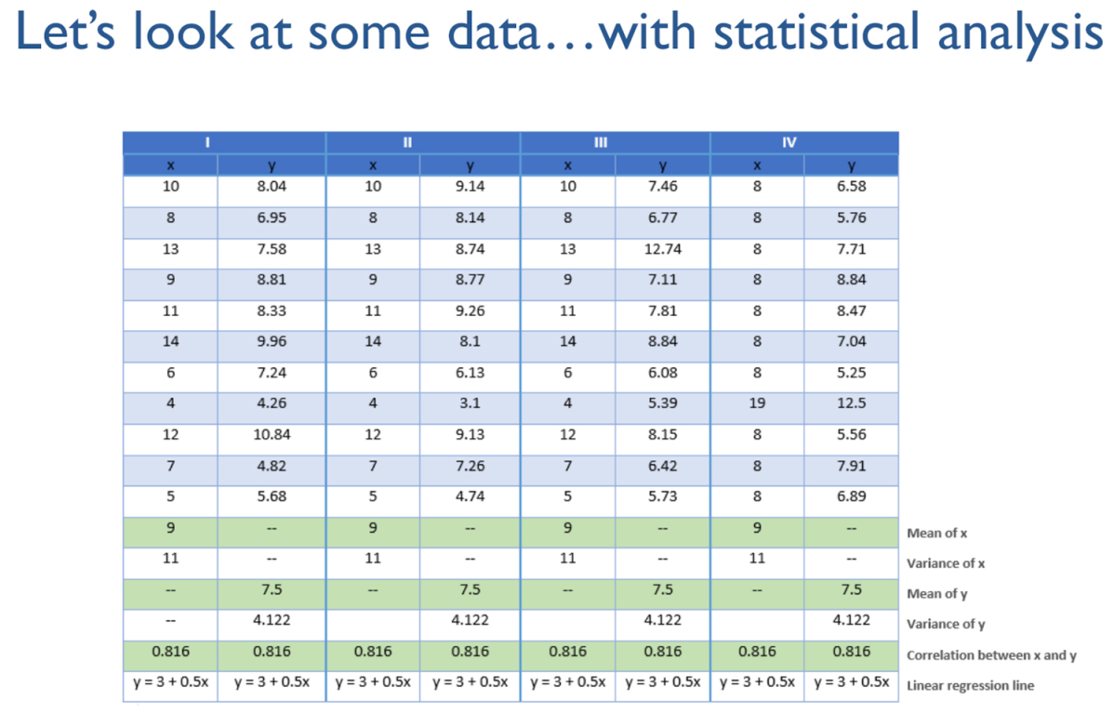
Need for Data Visualization

Slide 27
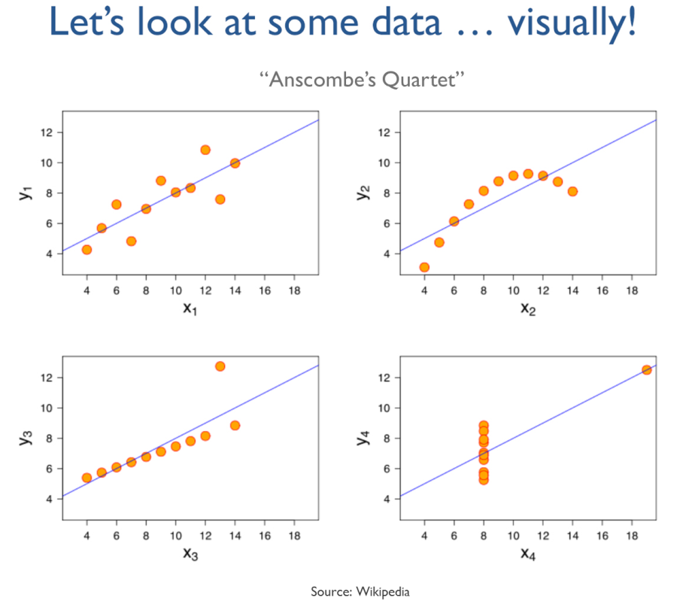
Need for Data Visualization

Slide 28
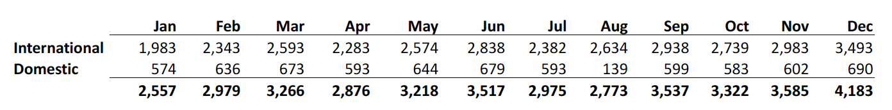
Need for Data Visualization
Can you quickly tell me what the trend of the international sales is? Increasing or decreasing?
What about the domestic sales?

Slide 29
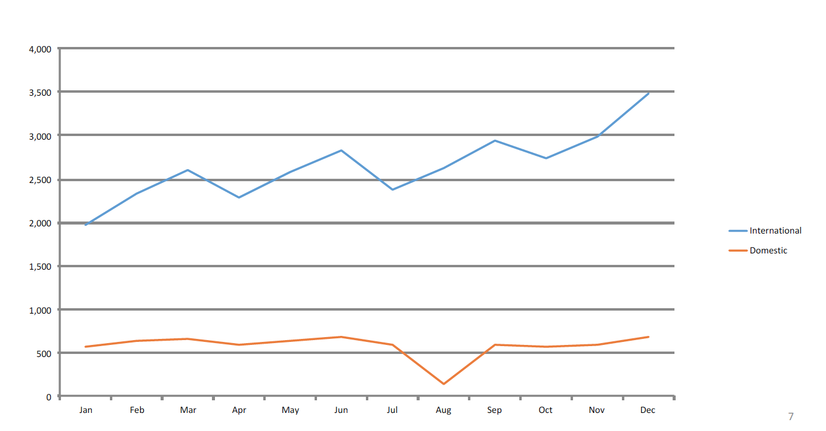
Need for Data Visualization
Graphics easily reveal the trends.

Slide 30
Why Visualize?
Data visualization is not a personal preference, to be done “just in case some people are more visual”. It is a necessity!
The previous slide is a classical example of how some insights can only be found through visualization.
The first step in understanding your data should always be to examine it visually. Visualization can play a critical role in helping you figure out what the interesting questions are.
Remember the picture superiority effect: pictures are retained at much higher rates than words.
“A picture is worth a thousand words”.

Slide 31
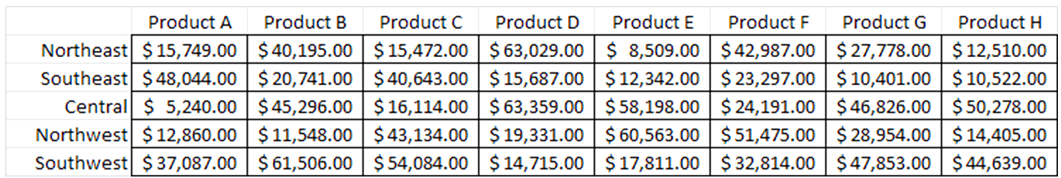
Why Visualize?
A good visualization reduces the time to insight. Here is a simple example.
Suppose you receive the following report of monthly revenues by product and region. Which were your five highest-revenue product / regions last month?

Slide 32
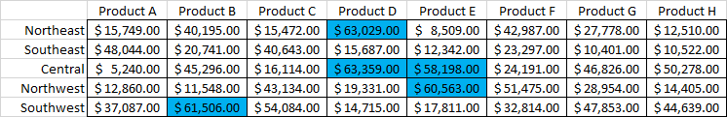
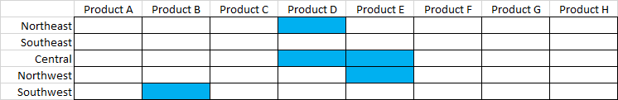
Why Visualize?
Let us add color.
For some applications, eliminating all distractions with a very simple visualization can be effective.

Slide 33
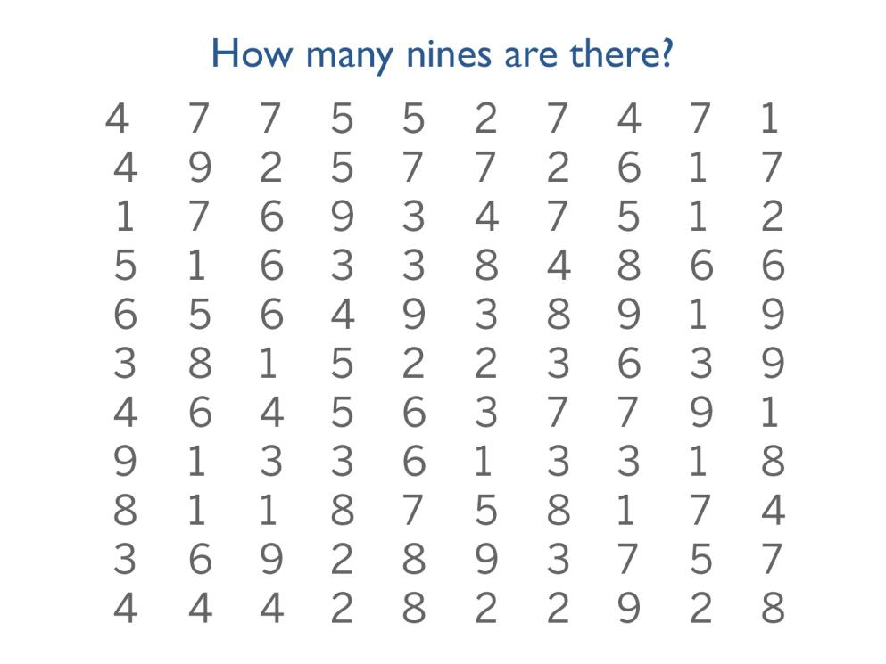
Why Visualize?

Slide 34
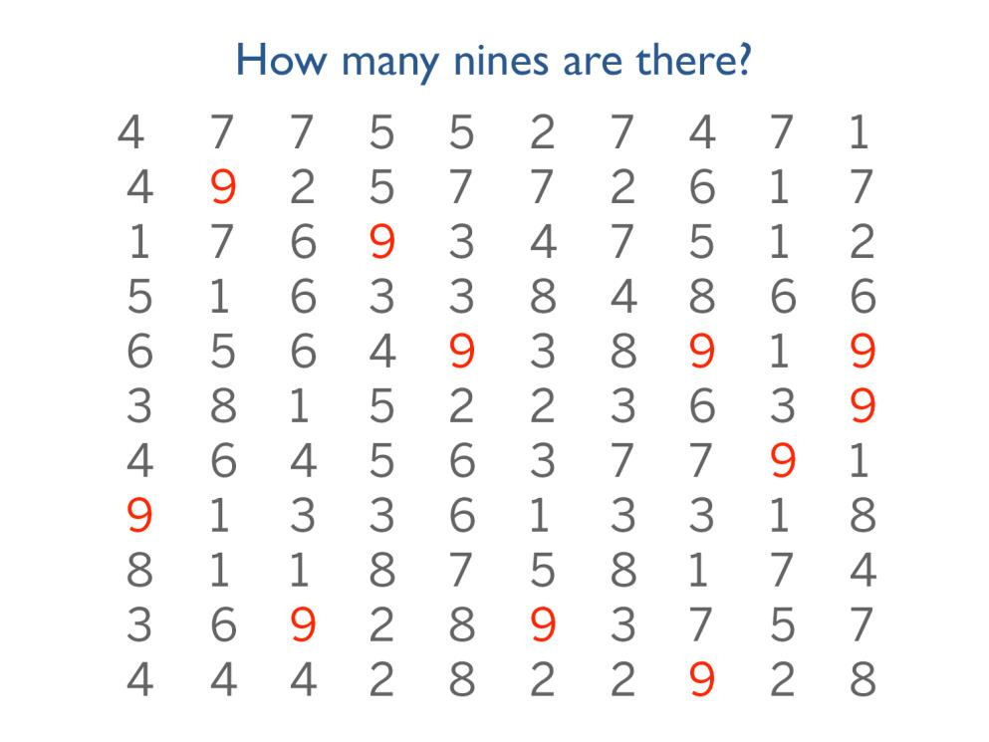
Why Visualize?

Slide 35
Effective Visualization
Choose appropriate axis levels.
Start at zero baseline.
If small differences matter, then exhibit differences rather than levels.
Example: plot changes from prior years.

Slide 36
Effective Visualization
Use about 2/3 of the graph for the data.

Slide 37
Effective Visualization
Choose appropriate order.
Avoid random order.
Use the order in data (highlights as needed).

Slide 38
Effective Visualization
Choose appropriate order.
Avoid random order.
Use the order in data (highlights as needed).

Slide 39
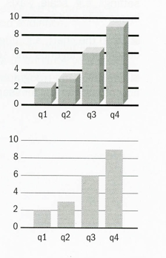
Effective Visualization
Get rid of chart-junk.
Let the data speak. Remove all ink that is not serving a purpose.
Above all else, show the data.

Slide 40
Effective Visualization
Maximize the data ink ratio.
Data ink ratio = data-ink / total ink.
Low Data Ink Ratio
High Data Ink Ratio

Slide 41
Effective Visualization
Books that you might be interested.

Slide 42
Summary
Getting familiar with data types.
Summarization and distribution analysis of numerical data.
Summarization of categorical data.
Understanding the necessity of visualization.
Homework for today: install Tableau and Python on your computer.

